Slide 1

General Assembly
In-person meeting, October 23rd 2025

Slide 2

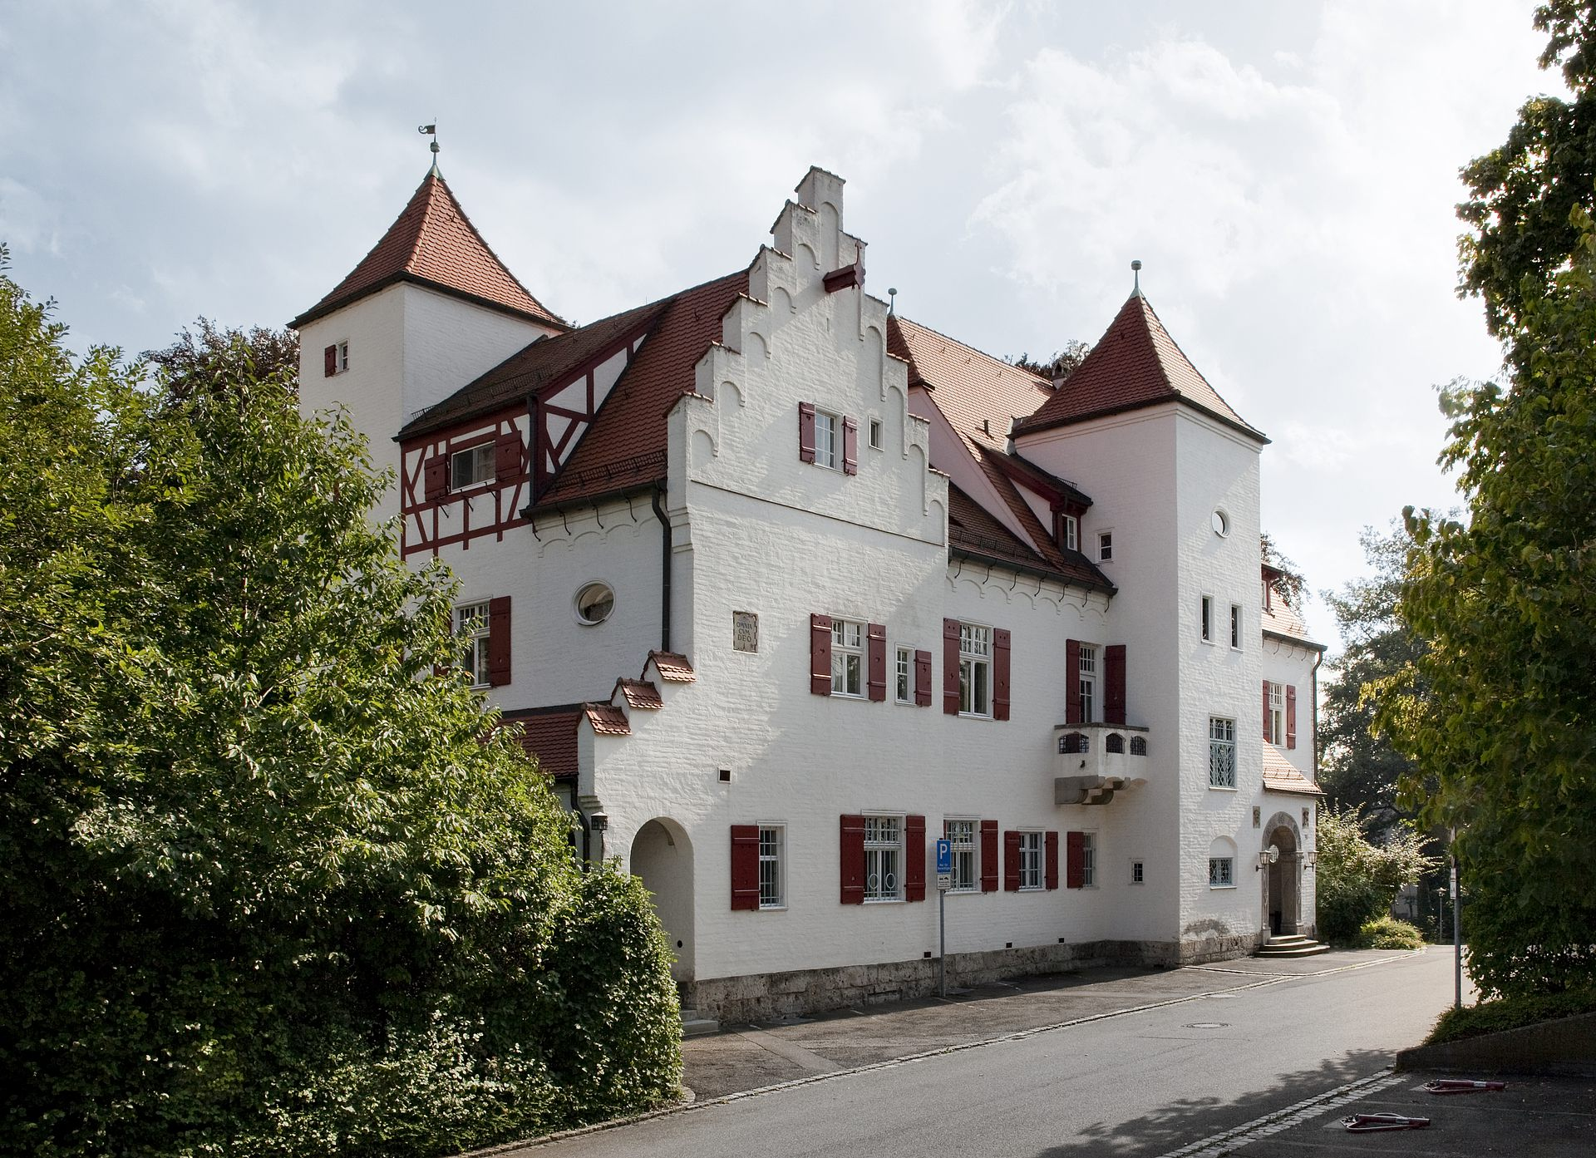











Annual Meeting 2025
Agenda - Thursday, October 23rd
Time | Rittersaal, Villa Eberhardt
11:30 - 12:30 | Reception & Lunch
12:30 - 13:00 | Welcome (A Beer, V Rasche)
13:00 - 14:15 | Status Reports & Milestones, Work Package 1 & 2 (I Schwartz, V Rasche)
14:15 - 15:30 | Status Reports & Milestones, Work Package 3 & 4 (F Schilling, M Bock)
15:30 - 16:00 | Group Picture / Coffee Break
16:00 - 16:30 | Project extension proposal (I. Schwartz)
16:30 - 17:15 | Impact and plan for clinical trials, including timeline / milestones (V. Guyot)
17:15 - 17:30 | Coffee Break
17:30 - 18:00 | Impact and plan for preclinical trials (F. Schilling)
18:00 - 18:15 | ToDos for the project extension (L. Hägele
18:15 - 18:30 | Come together, Summary, Meeting End (A. Beer, V. Rasche)
19:00 - Open End | Dinner & Social Event: .

Slide 4
AP X.Y: Scientific Highlight
Name

